Slide 1
Deep Learning Final Presentation
Sean Graham

Slide 2
Part 1

Slide 3
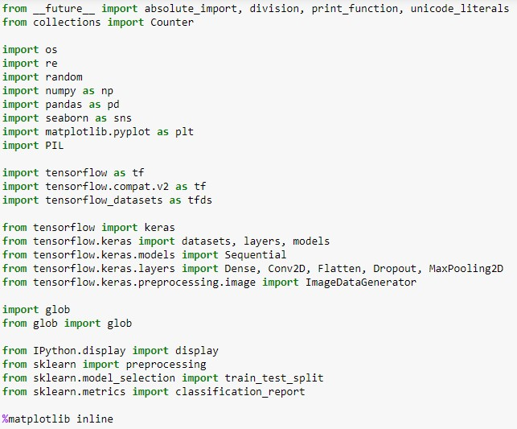
Load packages
Import the necessary items first.

Slide 4
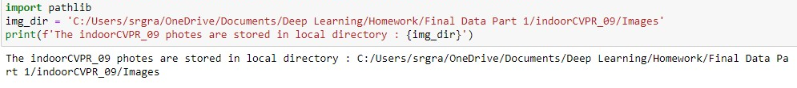
Step 1: Download the dataset from Kaggle into the local disk and unzip it
Save to “img_dir.”

Slide 5
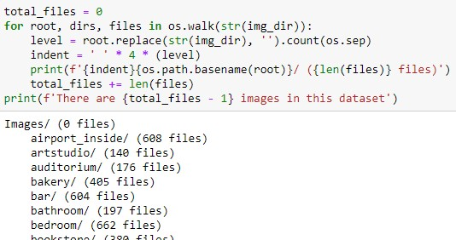
Find number of images in each subfolder
There are 15,619 images total.

Slide 6
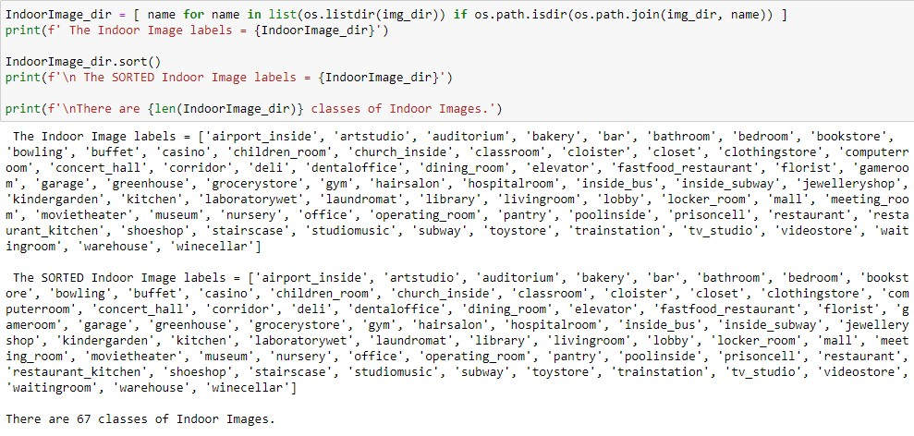
Print subfolder names
There are 67 in total.

Slide 7
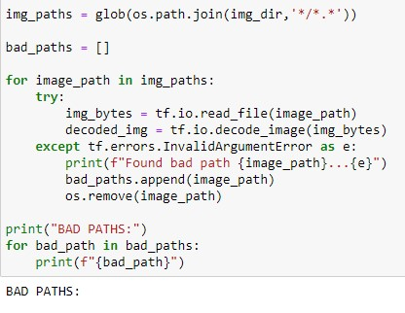
Remove corrupted images
Bad pathways were removed previously.

Slide 8
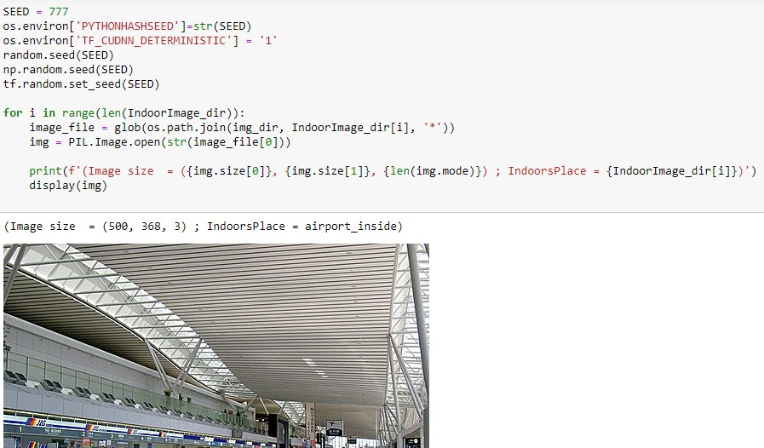
Fix output and display sample images
Use seed value of 777.
Display one from each folder.

Slide 9

Set values
Establish batch size, height, width, and split.

Slide 10
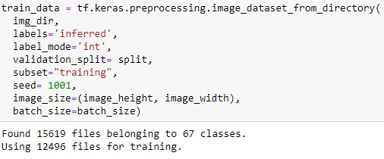
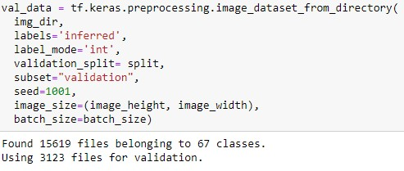
Set training and validation data
There are 15,619 training images and 3,123 validation images.

Slide 11
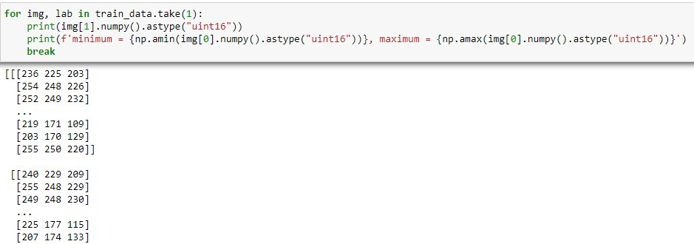
Visualize as matrices

Slide 12
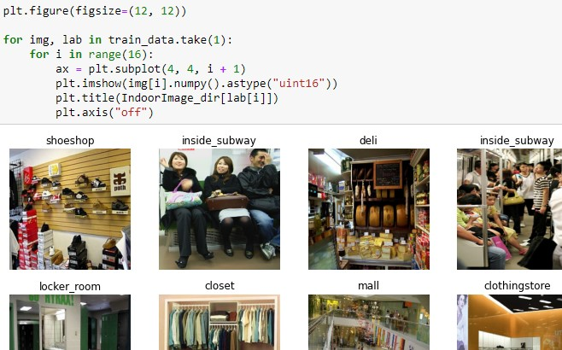
Plot 4x4 sample of images
Use appropriate labels.

Slide 13
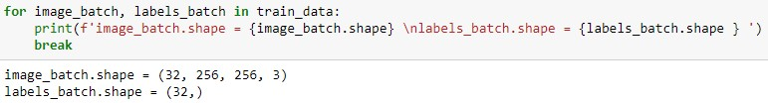

Double check parameters and configure the dataset
Apply caching, shuffle, and prefetch.

Slide 14
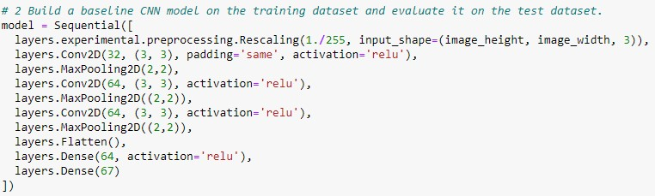
Step 2: Build a baseline convolutional neural network on the training dataset and evaluate it on the test dataset
Add to model layer by layer.

Slide 15
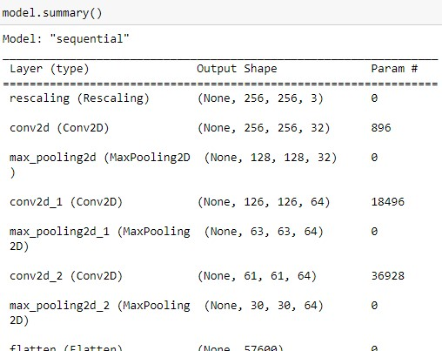
Summarize the model

Slide 16
Configure the model

Slide 17
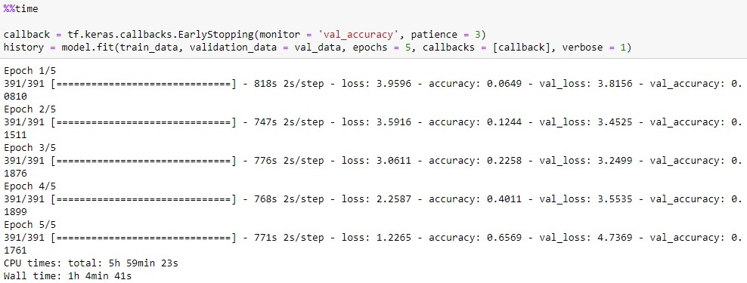
Train the model
Epochs are set to 5 and patience to 3.

Slide 18
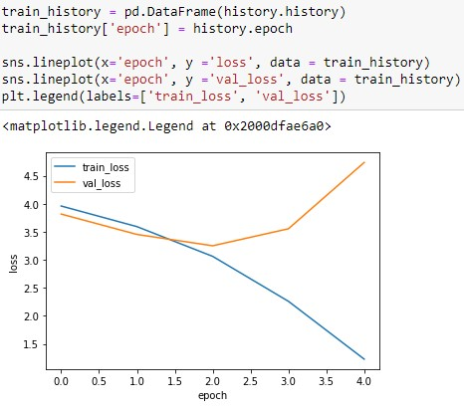
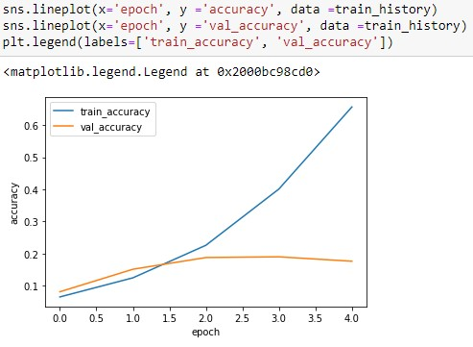
Make plots

Slide 19


Run classification report

Slide 20
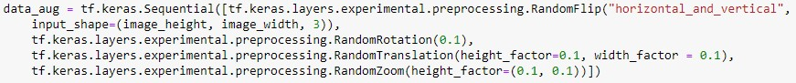
Step 3: Build a second CNN model with data augmentation and dropout layers
Apply transformations to images.

Slide 21
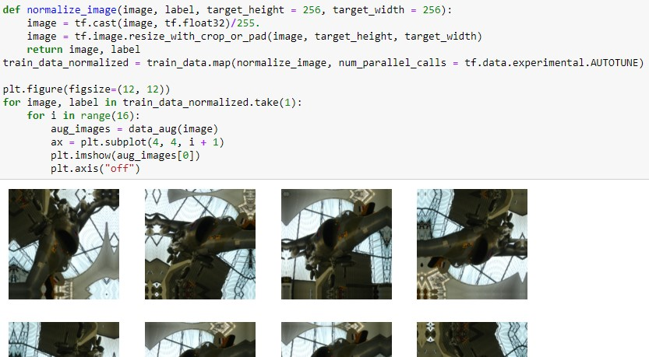
Normalize images and print sample
Fix height and width, divide by 255, and produce 16 images.

Slide 22
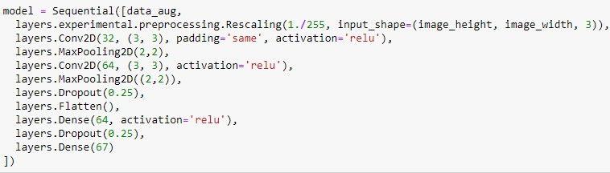
Build the model
Build layers with necessary changes.

Slide 23
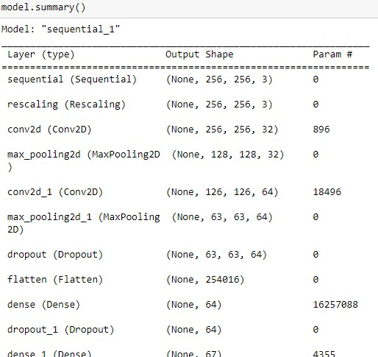
Summary

Slide 24
Model configuration

Slide 25
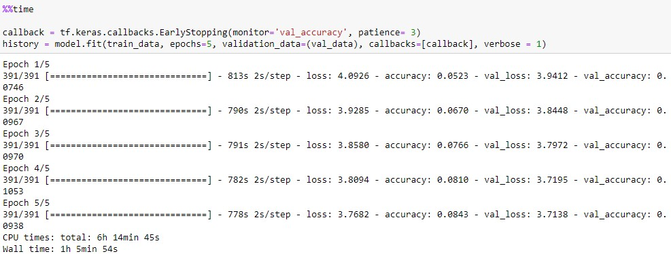
Training

Slide 26
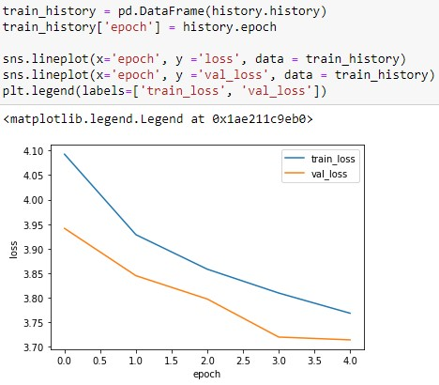
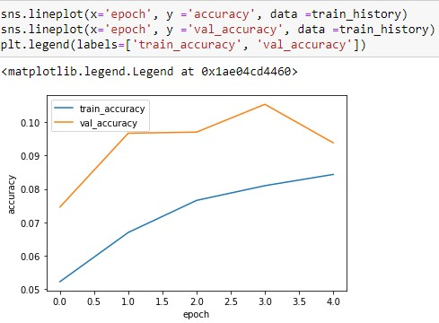
Make plots

Slide 27


Classification report

Slide 28
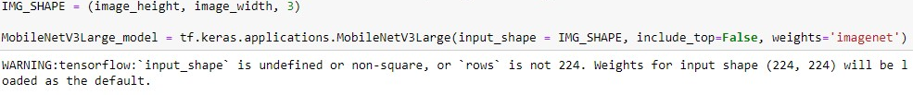
Step 4: Build a CNN model based on a pre-trained model
Continue to use the same parameters.

Slide 29
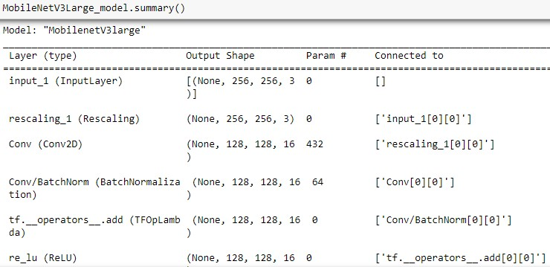
Run summary

Slide 30

Freeze convolutional base and import function from model
Ensure the weights aren’t updated.

Slide 31


Adjust dimensions
Convert 4D to 2D using GlobalAveragePooling2D.

Slide 32
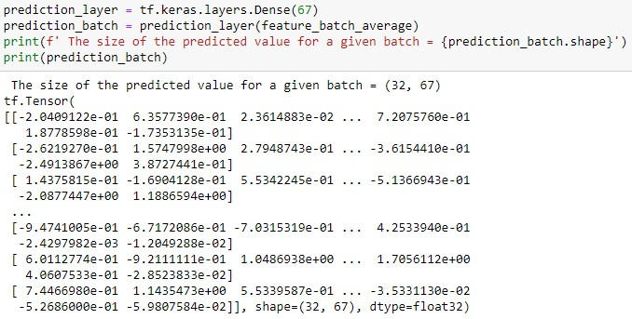
Customize top layer
Outputs a 32x67 matrix.

Slide 33
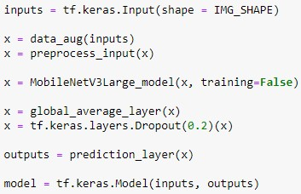
Create model using transfer learning
Add the layers that have been created.

Slide 34

Configure model
Classes are encoded as integers.

Slide 35
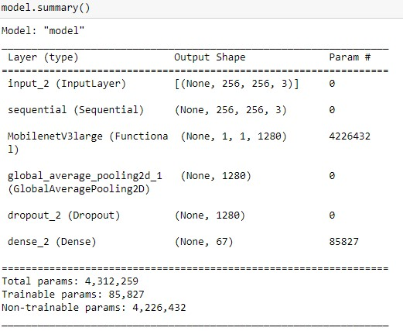
Run summary

Slide 36
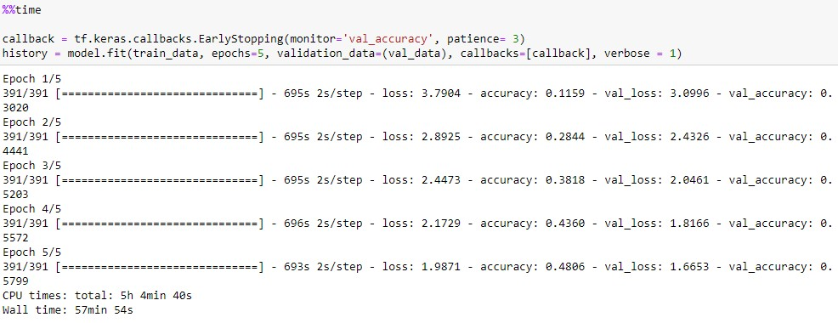
Train the model

Slide 37
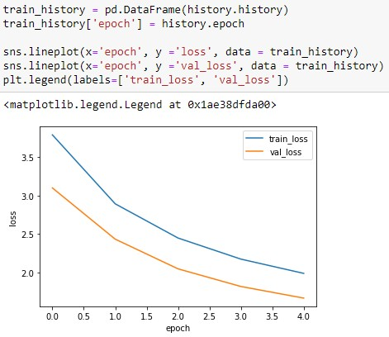
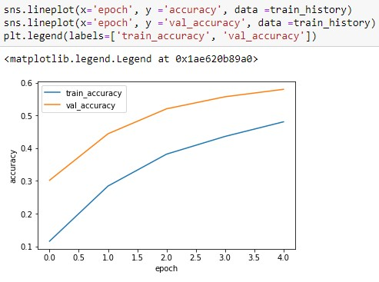
Make plots

Slide 38


Classification Report

Slide 39
Step 5: Which of the three models is best?
Question 2 has the best model; the accuracy is highest.

Slide 40
Part 2

Slide 41
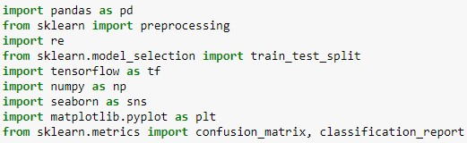
Load Packages
Load necessary items first.

Slide 42
Step 1: Download the dataset from Kaggle into the local disk and unzip it

Slide 43
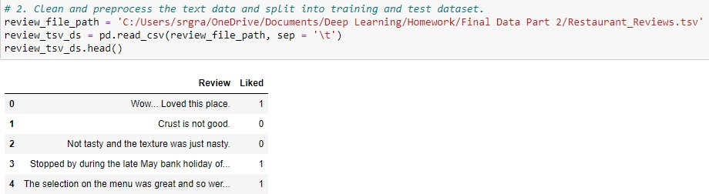

Step 2: Clean and preprocess the text data and split it into training and test data

Slide 44
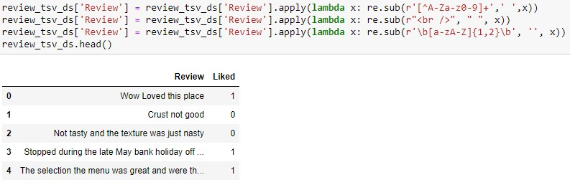
Remove special characters, punctuation, spaces, and words shorter than 2 letters

Slide 45

Split the data, turn into numerical values, perform text vectorization, and fit layer
Specify a vocabulary size of 1000.

Slide 46
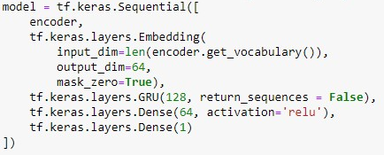
Step 3: Build a baseline RNN using and embedding layer and GRU

Slide 47

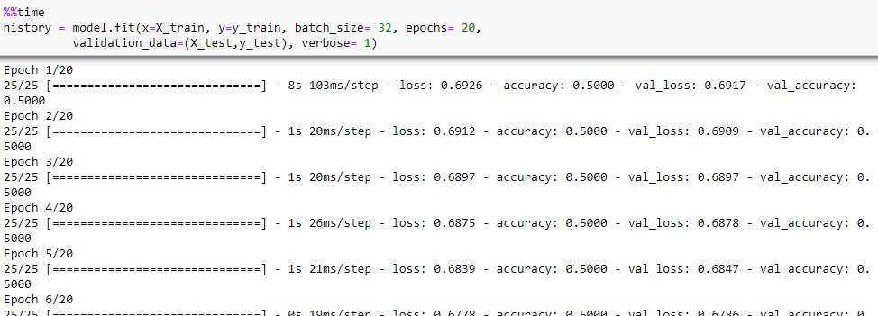
Compile and train the model

Slide 48
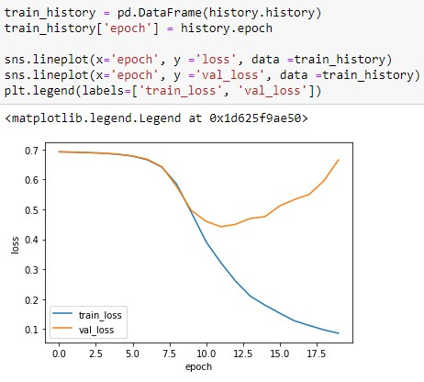
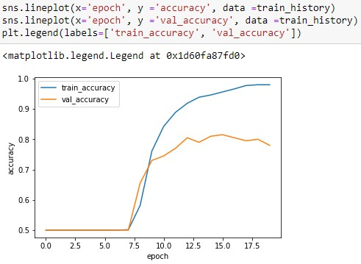
Make plots

Slide 49

Forecast labels and get confusion matrix
For the confusion matrix, (79 + 77) / (79 + 21 + 23 + 77) = 0.78.

Slide 50
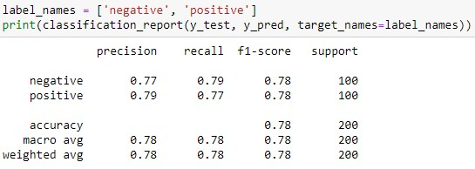
Classification report

Slide 51
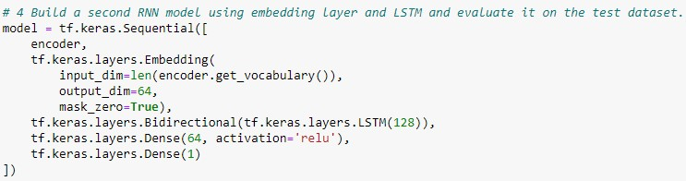
Step 4: build a RNN using embedding and LSTM

Slide 52

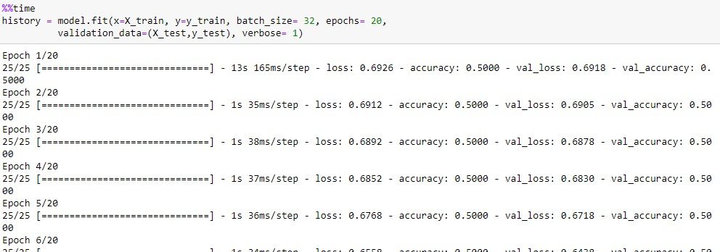
Compile and train the model

Slide 53
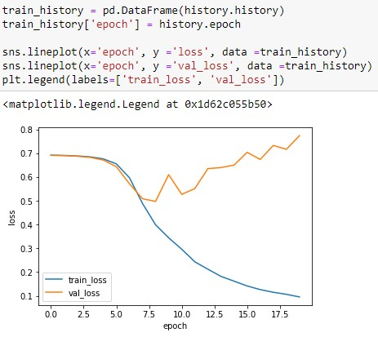
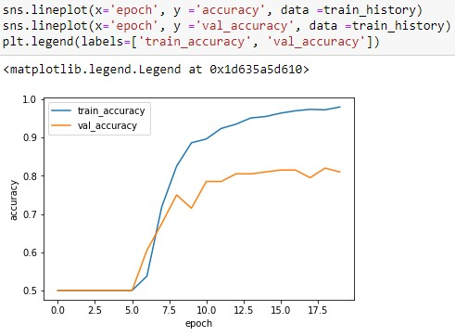
Make plots

Slide 54

Forecast labels and confusion matrix
For the confusion matrix, (84 + 78) / (84 + 16 + 22 + 78) = 0.81.

Slide 55
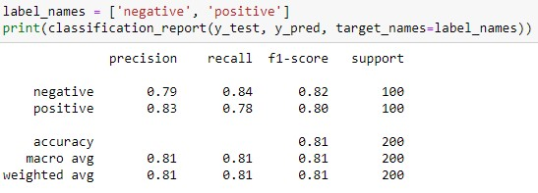
Classification report

Slide 56
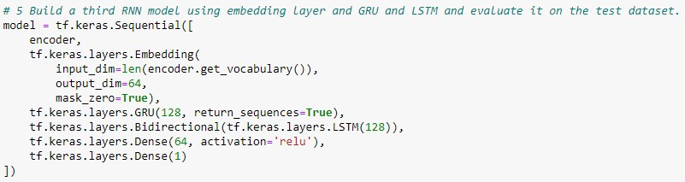
Step 5: Build a RNN model using embedding, GRU, and LSTM

Slide 57

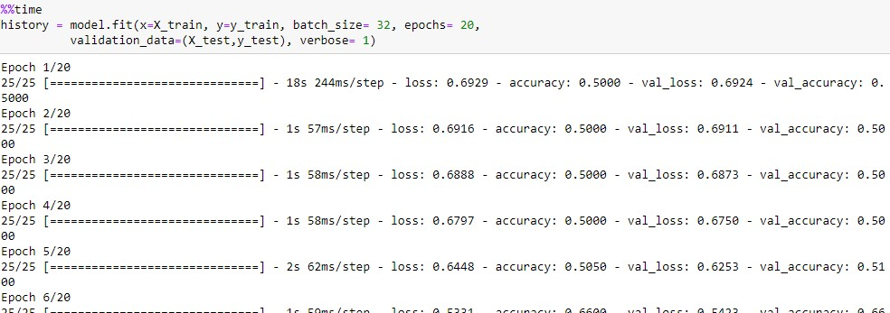
Compile and train model

Slide 58
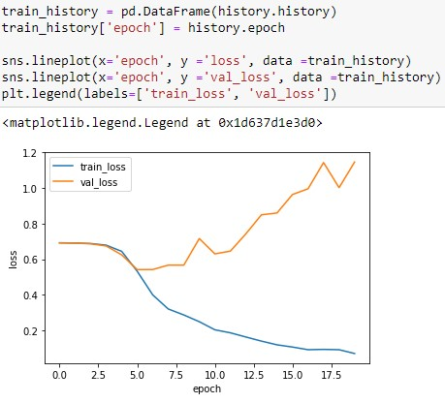
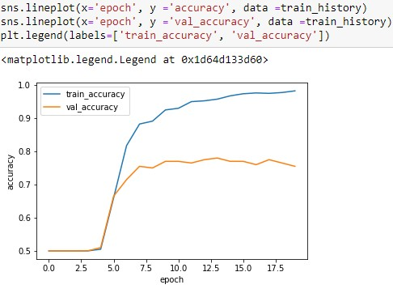
Make Plots

Slide 59

Forecast labels and confusion matrix
For the confusion matrix, (78 + 73) / (78 + 22 + 27 + 73) = 0.76.

Slide 60
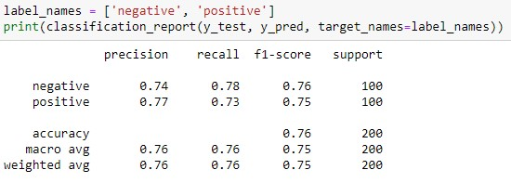
Classification Report

Slide 61
Step 6: Which of the three models is best?
Question 4 has the best model; the accuracy is highest.
Running again may produce different results.

Slide 62
Questions?

